Slide 1



Speech Enhancement in TTS
Ananyapam De

Slide 2
Flow:
Categories of Speech Enhancement methods
Datasets
Brief description, math and intuition of the implemented filters and examples
Hypothesis
Which method works best for which noise class?
Which method works best for which SNR level?
Intelligibility metrics and Observations
Ongoing work

Slide 3
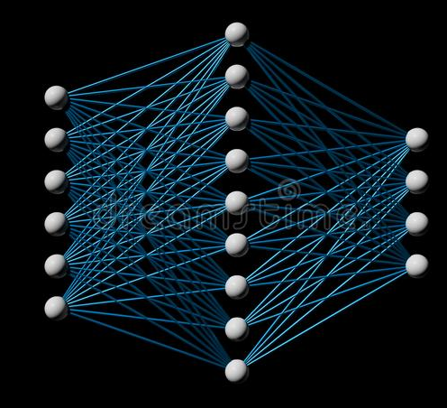
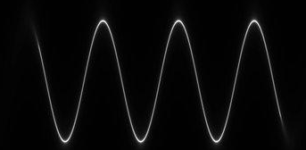
Speech Enhancement Techniques
Signal Processing Deep Learning

Slide 4
Spectral-Subtractive Algorithms
Assuming additive noise to the signal: y(n) = z(n) + s(n)
Statistical Model Based Algorithms
Estimating the spectrum of clean signal using the statistical techniques
Subspace Algorithms
Assuming the noisy signal can be decomposed as a direct sum of the subspaces containing the clean signal and the pure noise

Slide 5

Real world dataset: NOIZEUS
30 audio samples + distorted to different degrees and different noise classes
SNR Ratios: A) 0 dB B) 5 dB C) 10 dB D) 15dB
Exhibition
Car
Airport
Train
Babble
Restaurant
Station
Street

Slide 6
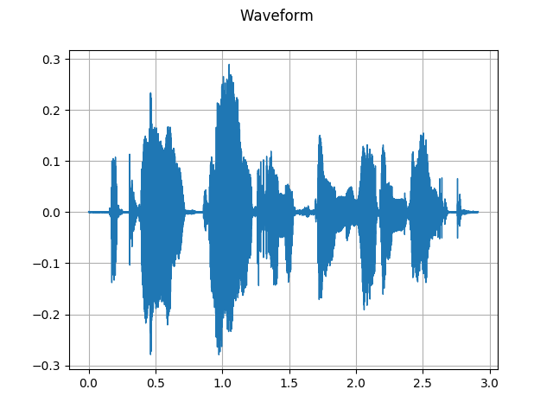
Clean Audio Sample

Slide 7
Implemented Filters-
Wiener Filter
Kalman Filter
Spectral Subtraction (Over subtraction)
Bayesian MMSE Filter
Bayesian MMSE Log Filter

Slide 8
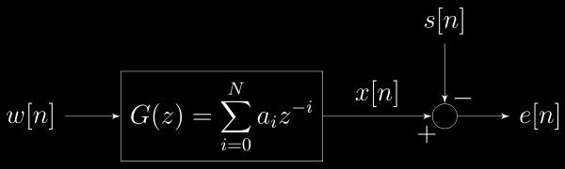
Wiener Filter
The optimal linear complex spectral estimator which minimizes the expected mean squared error
Constraint: Linear + time invariant

Slide 9
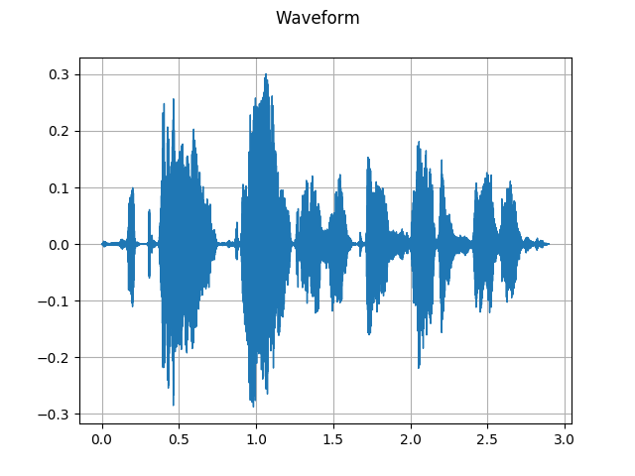
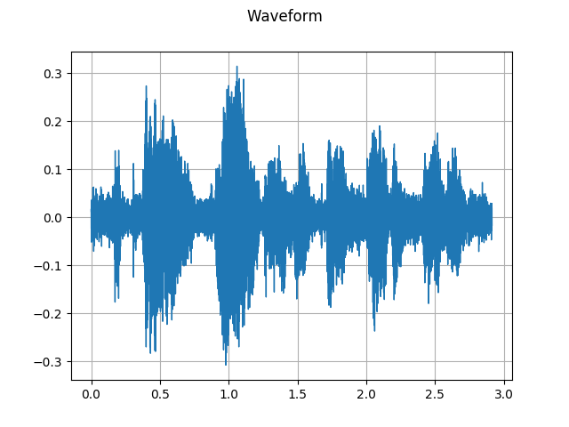
Wiener Filter Noisy Sample
Notes:
So this is what the filter does to our input waveform-

Slide 10
Intuitions and Properties
When SNR ratio is high, the filter does not provide noise reduction, that is, the noisy signal passes unaltered (hence no speech distortion).
When SNR ratio is extremely low, the output of the Wiener filter is heavily attenuated, which provides undesirable distortion in the speech.
Notice a tradeoff between no speech enhancement and undesirable speech distortion.

Slide 11
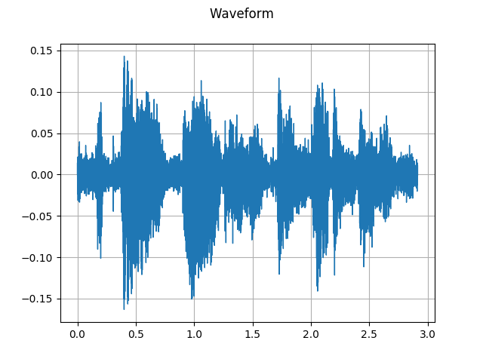
Kalman Filter Noisy Sample

Slide 12
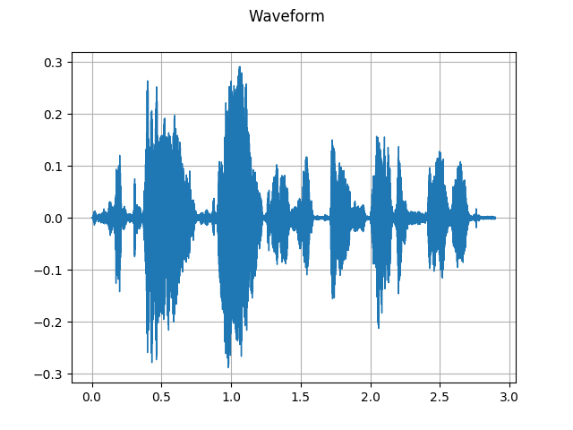
OverSubtraction Noisy Sample

Slide 13
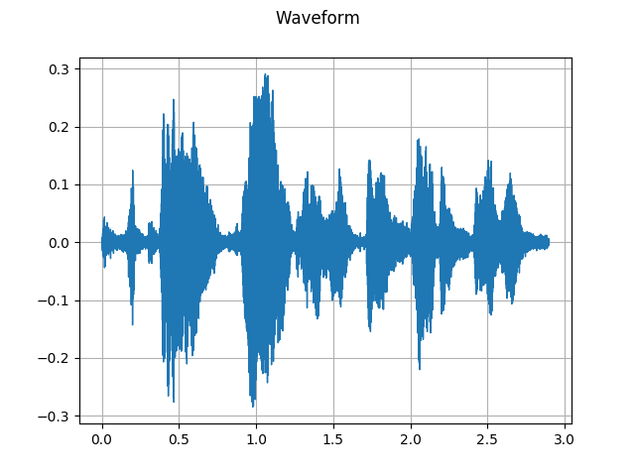
Bayesian MMSE Filter Noisy Sample

Slide 14
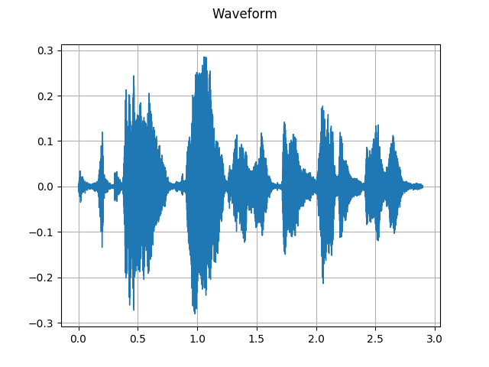
Bayesian MMSE Log Filter Noisy Sample

Slide 15
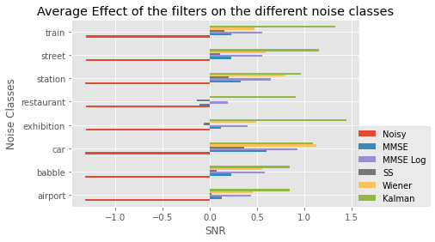
Filter performance (SNR) on noise classes-

Slide 16
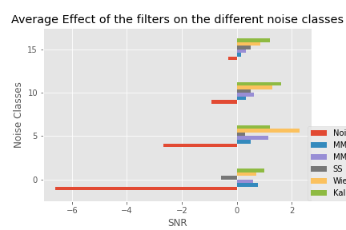

Filter performance (SNR) on different SNR levels-

Slide 17
Observations on NOIZEUS
Notice their overall behaviours-
Kalman >~ Wiener > MMSE Log > MMSE > Spectral Subtraction
Kalman filters works really well because the assumptions under which it is based are very realistic.
Wiener Filter performs well on mid ranged SNR audios ie from range 5 SNR to 10 SNR
MMSE Log almost always performs better than MMSE as it’s an improvement on the previous one
Over Subtraction method does not perform well because of it’s extremely sensitive hyperparameters

Slide 18
Intelligibility Metrics/ Voice Quality Test Algorithms
PESQ (Perceptual Evaluation of Speech Quality)
STOI (Short Term Objective Intelligibility)
MCD (mel-cepstral distortion)
GPE (Gross Pitch Error)
FFE (F0- Frame Error)

Slide 19
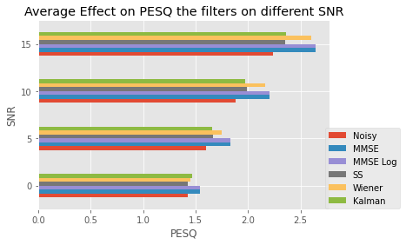
PESQ Metric
Pe
Effect of filters on PESQ on audios of different SNR’s

Slide 20
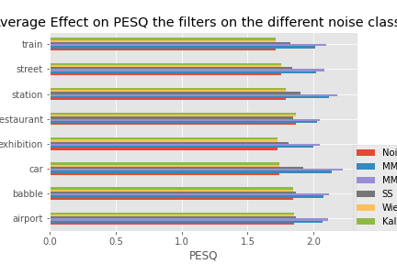
PESQ Metric
Filter effects on PESQ on different noise classes

Slide 21
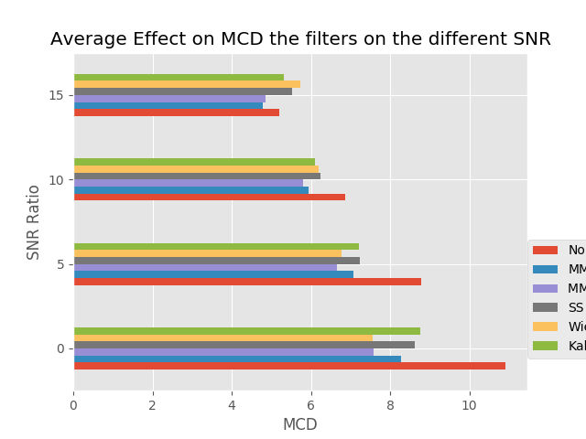
MCD Metric
Effect of filters on MCD on audios of different SNR’s

Slide 22
Observations on the TTS Dataset
Clean Audio
Filtered Audio
Pretty bad :(
Signal Processing Filters do not perform well on the TTS dataset unlike real world noise datasets
Possible reasons: TTS dataset does not satisfy the assumptions of the filters
Noise is not additive as NOIZEUS is created
Can’t expect subspace decomposition
Very subtle noise instead of coarse noise

Slide 23
Ongoing Work!!
Testing out some more metrics!
Deep Learning Methods on the TTS Dataset
Facebook Denoiser
RNN Noise
How do our methods perform on the different types of noise on the TTS Dataset

Slide 25

Over subtraction [Berouti et al]
Subtract an overestimate of the noise power spectrum, while preventing the spectral components from going below a preset minimum value
(α: Oversubtraction factor and β:Spectral floor parameter)

Slide 26
Appendix-
Kalman Filter (Linear Quadratic Estimation) [Orchisman]
Recursive State Estimation technique
Most optimal filter under these assumptions of normality
Assume that noise is gaussian
x_{k} = F_{k} x_{k-1} + B_{k} u_{k} + w_{k} where w_{k} ~ N(0, Q_{k})
z_{k} = H_{k} x_{k} + v_{k} where v_{k} ~ N(0, R_{k})

Slide 27


Bayesian MMSE Filter
Optimal estimators that minimized the mean-square error between the estimated and true magnitude spectra-

Slide 28

Bayesian MMSE Log Filter
Optimal estimators that minimized the mean-square error between the estimated and true log magnitude spectra-

Slide 29
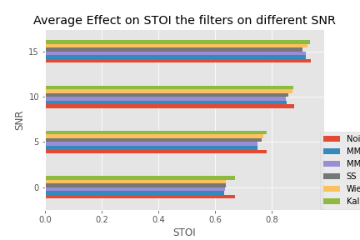
STOI Metric
Effect of filters on STOI on audios of different SNR’s

